Slide 1
RUNGTA COLLEGE OF DENTAL SCIENCES & RESEARCH
TITLE OF THE TOPIC-
ACTIVATOR & BIONATOR
DEPARTMENT OF ORTHODONTICS AND DENTOFACIAL ORTHOPAEDICS

Slide 2
Specific learning Objectives
CORE AREAS | DOMAIN | CATEGORY
HISTORY | AFFECTIVE | DESIRE TO KNOW
ACTIVATOR INDICATIONS & CONTRAINDICATIONS | COGNITIVE | MUST KNOW
PRINCIPLE | COGNITIVE | MUST KNOW
CONSTRUCTION BITE | PSYCHOMOTOR | NICE TO KNOW
APPLIANCE FABRICATION & TRIMMING | PSYCHOMOTOR | MUST KNOW
BIONATOR INDICATIONS | COGNITIVE | NICE TO KNOW
PHILOSOPHY | COGNITIVE | DESIRE TO KNOW
TYPES | COGNITIVE | MUST KNOW

Slide 3
CONTENTS:
ACTIVATOR
HISTORY
INDICATIONS & CONTRAINDICATIONS
PRINCIPLE
CONSTRUCTION BITE
APPLIANCE FABRICATION
TRIMMING OF ACTIVATOR
BIONATOR
INDICATIONS
PHILOSOPHY
TYPES

Slide 4
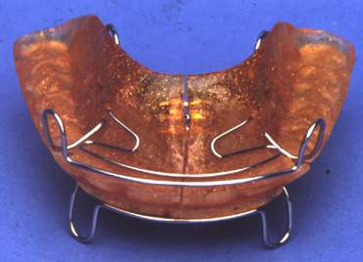
Activator
Activator is a loose fitting appliance which was designed by Andreasen and Haupl to correct retrognathic mandible.
The present form of the appliance came through various stages of development starting with the concept of ‘bite jumping’ introduced by Norman Kingsley (1879).
This was followed by Hotz’s Vorbissplatte which was a modification of Kingsley’s plate and was used to correct retrognathic mandible with deep bite.

Slide 5
Activator
Monobloc which was made up of a single block of vulcanite, was used by Pierre Robin to correct the airway obstruction in patients with micrognathia.
Later in 1908 Viggo Andreasen, modified the Hawley’s type of retainer, on the maxillary arch, to which he added a lower lingual horse shoe shaped flange which helped to position the mandible forward.
He called it the biomechanical working retainer. Later he teamed with Karl Haupl, and developed an appliance which they called as Norwegian appliance and later came to be known as the activator.

Slide 6
Activator
Synonyms
Biomechanic working retainer
Andreasen appliance
Nocturnal airway patency appliance
Norwegian appliance

Slide 7
Indications
Class II, Division 1 malocclusion
Class II, Division 2 malocclusion
Class III malocclusion
Class I open bite malocclusion
Class I deep bite malocclusion
As a preliminary treatment before major fixed appliance therapy to improve skeletal jaw relations
For post-treatment retention
Children with lack of vertical development in lower
facial height
Activators As Retainers [JCO 1980 Aug(529 - 545)]

Slide 8
Contraindications
Class I problems of crowded teeth caused by disharmony between tooth size and jaw size,
In children
with excess lower facial height and extreme vertical mandibular growth.
whose lower incisors are severely procumbent.
with nasal stenosis caused by structural problems within the nose or chronic untreated allergy.
Limited application in non-growing individuals.

Slide 9
Principle
Two principles
Force application —the source is usually muscular.
Force elimination —the dentition is shielded from normal & abnormal functional and tissue pressures by pads, shields, and wire configurations

Slide 10
Principle
Activator induces mucoskeletal adaptation by
Introducing new pattern of mandibular closure
Appliance fit loosely and pt has to move the mandible forward to engage the appliance

Slide 11
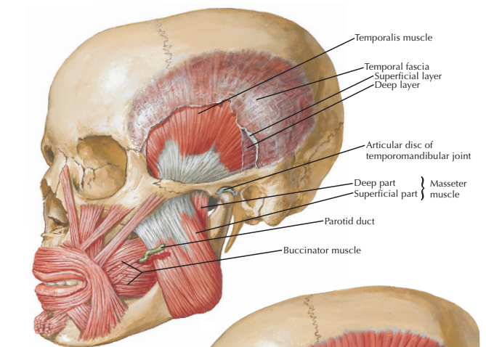
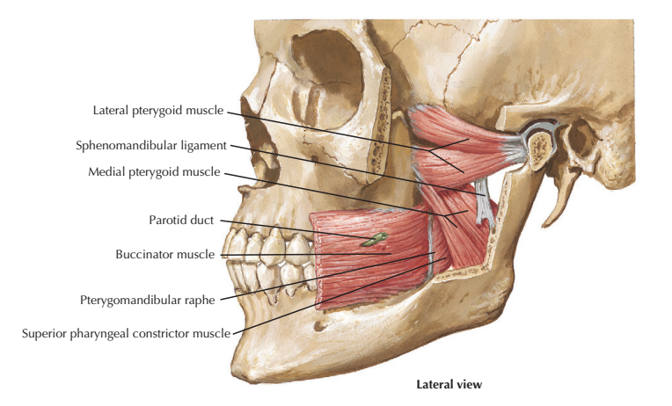
Principle
This will stretch the elevator muscles

Slide 12
Stretching and contraction generates kinetic energy
causes
Prevention of forward growth of maxilla and causing it to move distally
A reciprocal forward force on mandible

Slide 13
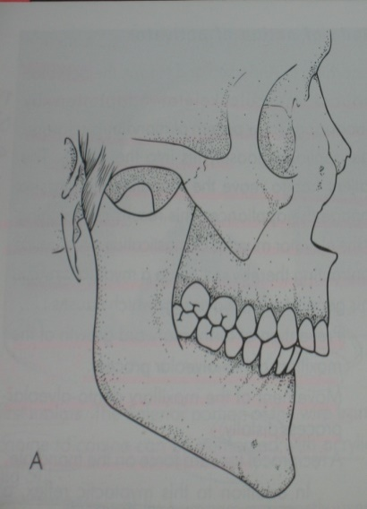
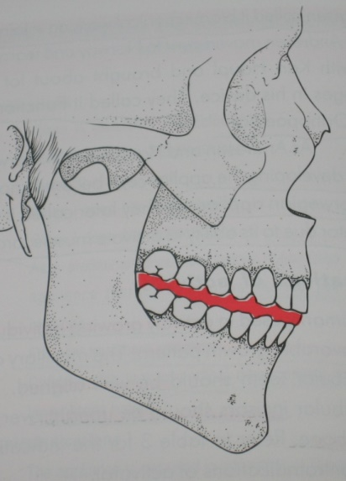
Construction Bite
Diagnostic preparation
Patient compliance
Clinical assessment + Patient’s motivation potential
Study model analysis
Molar relationship
Nature of midline discrepancy
Symmetry of dental arches
Curve of Spee
Crowding and other dental discrepancies

Slide 14
Treatment planning
Anterior positioning of the mandible
Opening the bite
General rules for construction of the bite
Forward positioning of mandible 7-8mm ; vertical opening = 2-4 mm
Forward positioning 3-5 mm; vertical opening = 4-6 mm

Slide 15
Lower construction bite with marked mandibular forward positioning
As a rule of the thumb the anterior advancement should not exceed more than 70% of the most protrusive position, and vertically it should be within the limits of inter occlusal clearance.
This kind of an activator with marked sagittal advancement with minimal bite opening is called H-activator
Indicated in persons with Class II Division 1 malocclusion with horiozontal growth pattern.

Slide 16
High construction bite with slight anterior mandibular positioning
Here mandible is positioned anteriorly by 3-5 mm only and the bite is opened vertically by 4-6 mm.
This kind of activator constructed with minimal sagittal advancement but marked vertical opening is called a ‘V’ activator
Indicated in Class II Division 1 malocclusion with vertical growth pattern.

Slide 17
Construction bite without forward positioning of mandible It is done in cases with deep bite, and open bite
Construction bite with opening and posterior positioning of the mandible In Class III cases bite is taken after retruding the mandible to a more posterior position.

Slide 18
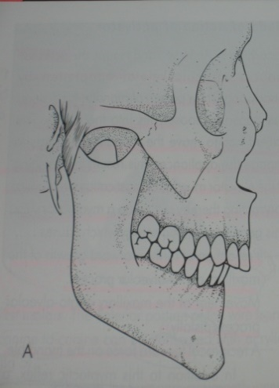
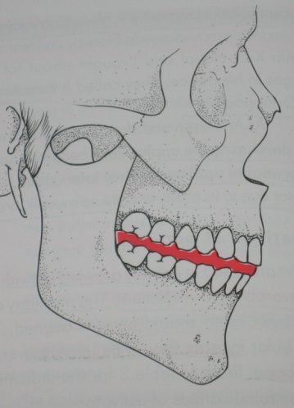
Execution of the Construction
Bite technique
A horseshoe-shaped wax bite rim
Patient position
Gently guiding the mandible into the predetermined position
The softened wax bite rim is placed in the mouth
The edge-to-edge incisal relationship and midline registration.
Wax cut away from the labial of the central incisors- midline observed and a correct reproduction of the incisal relationship established.

Slide 19
Wax is carefully removed from the mouth and checked on the upper and lower models
The margins trimmed with scissors - make sure the wax is close to all the cusps of the teeth.
The hardened wax bite - chilled and checked once again in the mouth.
The construction bite always be taken on the patient, not on the articulated models.

Slide 20
Preparation of Wire Elements A labial bow is prepared with 0.8 or 0.9 mm wire. The ends of the wire enter the acrylic body. The labial bow can be active or passive.
Fabrication of Acrylic Portions Appliance consists of three parts
• Maxillary part • Mandibular part • Interocclusal part
The maxillary and mandibular parts are same as \ the acrylic portions of upper and lower Hawley’s plate, but these are joined by an interocclusal part which makes this appliance into a single block.
The inter occlusal portion has the indentations of upper and lower teeth and caps the lower anteriors, which controls their supra-eruption and proclination.

Slide 21
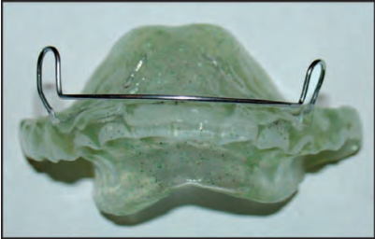

Slide 22
Trimming of the Activator
Activator therapy aims at providing a good skeletal as well as dentoalveolar relationship of upper and lower arches.
However, this is not possible by simply holding/posturing the mandible forward, in a predetermined position, without appropriate guidance for the erupting teeth.
Therefore, to achieve a proper three dimensional relationship of teeth, selective trimming of the activator is carried out.
Trimming can be done at the time of appliance insertion or as some clinicians suggest, it can be done after about a week’s time.

Slide 23
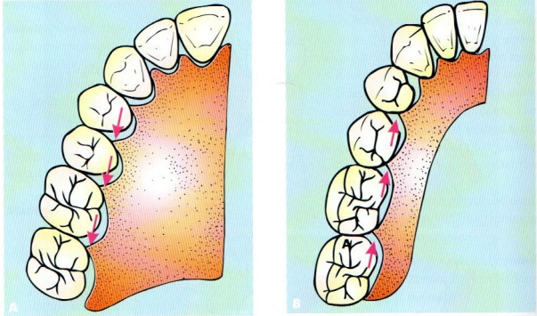
Trimming for Sagittal Control
a. Class II correction:
to encourage the mesial movement of the lower molar and distal movement of the upper molar.
Therefore the distopalatal surface in the maxillary and mesio lingual surface in the mandibular posterior segments are trimmed.

Slide 24
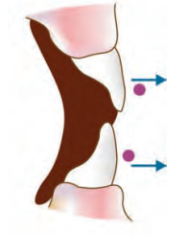
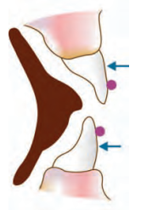
Trimming for Sagittal Control
b. Protrusion of incisors • In this case lingual surfaces of teeth are loaded with acrylic and a passive labial bow is given
c. Retrusion of incisors • Here the lingual surface is made totally free of acrylic and an active labial bow is given

Slide 25
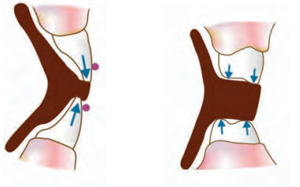
Trimming for Vertical Control a. Intrusion of teeth
• For this the incisal area is loaded with acrylic • Labial bow is placed below the greatest convexity at the incisal area for intrusion • In case of intrusion of posteriors load the surfaces of the teeth with acrylic

Slide 26
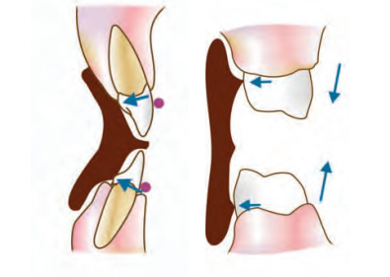
Trimming for Vertical Control b. Extrusion of teeth
• Here the lingual surface is loaded above the area of greatest convexity in the maxilla and below the area of greatest convexity in the mandible • Also the labial bow can be placed at the gingival 1/3 i.e. below the greatest convexity • In case of posterior extrusion the lingual surfaces below the greatest convexity are loaded.

Slide 27
MANAGEMENT OF THE APPLIANCE The appliance is to be worn 2 to 3 hours during the day for the first week. During the second week the patient sleeps with the appliance in mouth and wears it for 1-3 hours each day. The appliance is checked during the third week to evaluate the trimming. If the patient is wearing the appliance without any difficulty and following the instructions, checkup appointments are scheduled every 6 weeks.

Slide 28
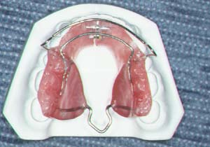
BIONATOR

Slide 29
The Bionator—a Modified Activator
Developed by Balter (1905)
Advantages over activator
Considerably less bulky than the activator.
It lacks the part covering the anterior section of the palate, which is contiguous to the tongue.
Children able to speak normally, though the appliance fits loosely in the mouth.
the bionator can be worn day and night except at meals.
An important feature - its freedom of movement in the oral cavity.

Slide 30
Indications
The dental arches are well aligned originally.
The mandible is in a posterior position (i.e., functional retrusion).
The skeletal discrepancy is not too severe.
A labial tipping of the upper incisors is evident.

Slide 31
Contraindications
1. The Class II relationship is caused by maxillary prognathism.
2. A vertical growth pattern is present.
3. Labial tipping of the lower incisors is evident.
Anterior posturing of the mandible with simultaneous uprighting of the lower incisors cannot be performed with the bionator.

Slide 32
PHILOSOPHY
According to Balters, “the equilibrium between the tongue and the circumoral muscles is responsible for the shape of the dental arches and that the functional space for the tongue is essential for the normal development of the orofacial system”
Balters designed an appliance, which could take advantage of tongue posture.
Thus he constructed an appliance whereby the mandible was positioned anteriorly, with the incisors in an edge to edge position.

Slide 33
This forward positioning brought the dorsum of the tongue in contact with the soft palate and helped accomplish lip closure.
Thus the principle of bionator is not to activate the muscles but to modulate muscle activity,
Thereby enhancing the normal development of the inherent growth pattern and eliminate abnormal and potentially deforming environmental factors.

Slide 34
BIONATOR TYPES
Standard Appliance.
The Open-Bite Appliance.
Class 3 appliance

Slide 35
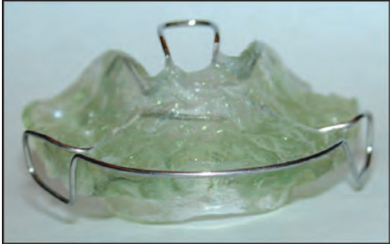
Standard Appliance
It consists of a lower horse-shoe shaped acrylic lingual plate extending from the distal of the last erupted molar to the corresponding point on the other side.
For the upper arch the appliance has only posterior lingual extensions that cover the molar and premolar regions. The anterior portion is open from canine to canine

Slide 36
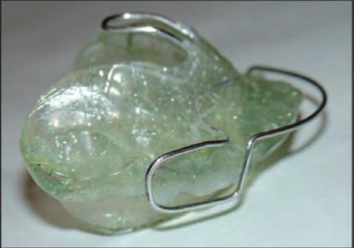
Standard Appliance
The palatal bar is formed of 1.2 mm hard stainless steel wire extending from the top edges of the lingual acrylic flanges in the middle area of the deciduous first molars
The palatal bar forms an oval, posteriorly directed loop that orients the tongue and mandible anteriorly to achieve a Class I relationship.

Slide 37
Standard Appliance
The labial bow is made from 0.9 mm hard stainless steel.
It starts above the contact point between the canine and deciduous upper first molar/ premolar.
It then extends vertically, making a rounded 90° bend to the distal along the middle of the crowns of the posterior teeth and extends as far as the embrasure between deciduous 2nd molar and permanent 1st molar.

Slide 38
Open Bite Appliance This is used to inhibit abnormal posture and function of the tongue.
The construction bite is kept as low as possible with acrylic bite blocks between the posterior teeth to prevent their extrusion.
The acrylic portion of the lower lingual part extends onto /upto the upper incisor region as lingual shield, to prevent tongue movements.
The labial bow is quite similar with the exception that the wire runs approximately between the incisal edges

Slide 39
Class III or Reverse Bionator
This type of appliance is used to encourage the development of maxilla.
The bite is taken in most possible retruded position, to allow labial movement of the maxillary incisors and reciprocally a slight restrictive effect on the lower arch.
The bite is opened about 2 mm only in the interincisal region.

Slide 40
ACTIVATOR
Activator is a tooth-borne appliance
This is a loose-ftting appliance
Activates the muscle, hence called activator.
Harnesses the muscle force
Does not act as an exercise device
Bulk of the appliance is placed within the teeth
Only one wire component
Activator is one single acrylic block
Mandibular advancement by 6–7 mm
Vertical opening is more
Worn during night-time
SUMMARY

Slide 41
REFERENCES
Textbook of Orthodontics – Gurkeerat Singh, Jaypee Brothers; 2nd Edition
Orthodontics – The Art and Science, S.I Bhalajhi, AryaMedi Publishing; 7th Edition
Textbook of Orthodontics – Sridhar Premkumar, Elsevier; 1st Edition
Orthodontics: Diagnosis and Management of Malocclusion and Dentofacial Deformities – O.P Kharbanda, Elsevier; 1st Edition

Slide 42
Question & Answer Session

Slide 43
Thank you

